Slide 1
EST revision
Year 12 Integrated General

Slide 2
EST Marking keys
Most questions are multi-sectioned
Meaning questions can be up to 20 marks
However they’re broken up into sections (1a, 1b, 1c, 1d etc.)
The marking key will describe what is required for each mark
I.e. A 3 mark question will tell us what’s needed for a 1, 2 and 3 mark response

Slide 3
Meanings of words
Name (1 mark)
Simply naming something that’s asked from you i.e. name one abiotic factor (sunlight)
Write (2 marks)
Can involve providing an answer with a sentence or two i.e. write a hypothesis for this
Construct (3-5 marks)
Involves mainly graphs, sometimes diagrams i.e. construct a line graph from this table.
State (1-2 marks)
Similar to ‘name’ but could be a sentence long i.e. state one reason why…..
Explain (2-3 marks)
Quite common, often involves the most detail (a few sentences) can also be a combination of things such as defining the topic (1 mark) and then explaining

Slide 4
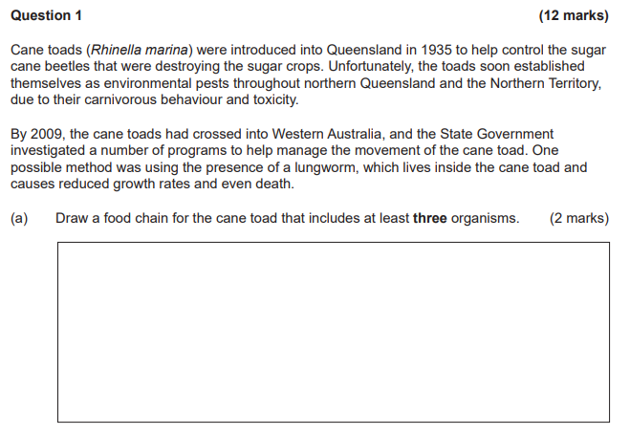
Example 1
What is the question actually asking us to do?
Where would the 2 marks come from?
What words are highlighted?

Slide 5
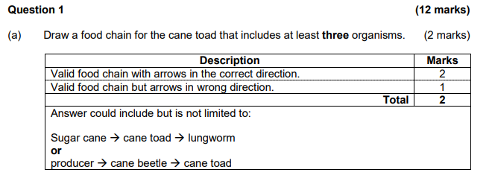
Example 1 Answer

Slide 6
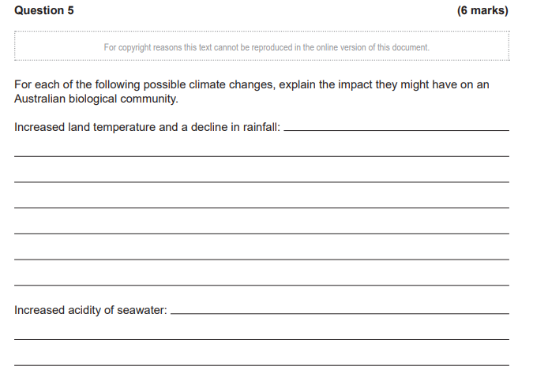
Example 2
What is the question actually asking us to do?
Where would the 6 marks come from?
Is there a way we can deconstruct this?

Slide 7
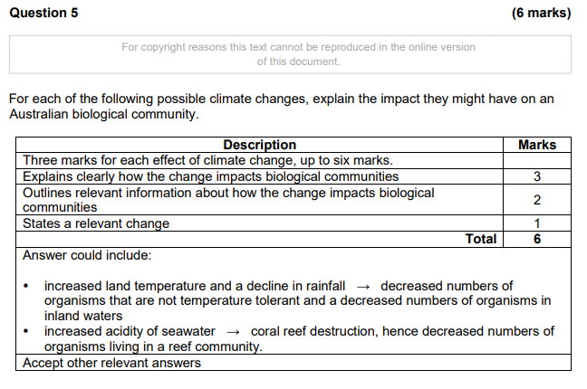
Example 2 Answer

Slide 8
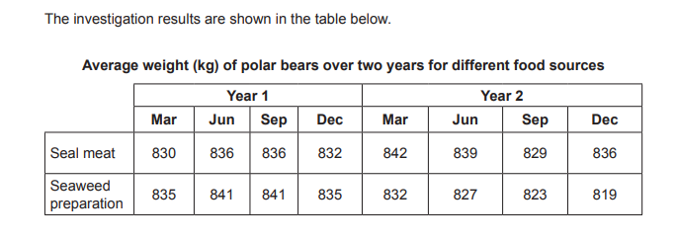
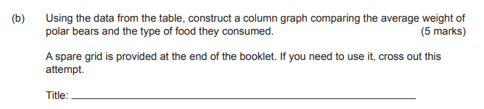
Example 3
What elements are involved in a graph?
What hints does the question give you? (What do we need to draw?)
What scale would you use on the x and y axis?

Slide 9
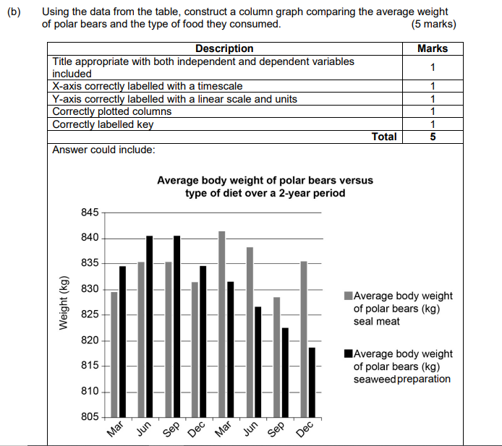
Example 3 Answer

Slide 10
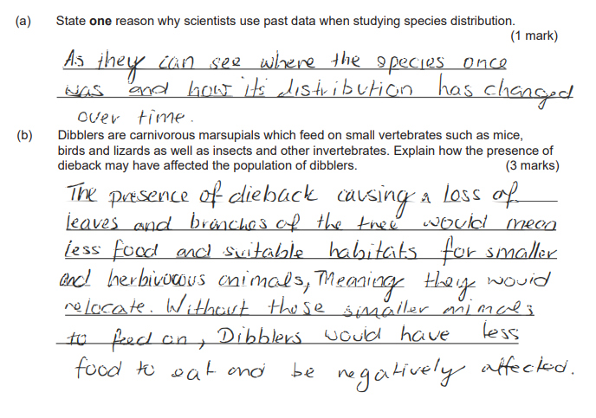
Strong student answer
How many marks do you think they received for part a?
1/1
How many marks do you think they received for part b?
3/3

Slide 11
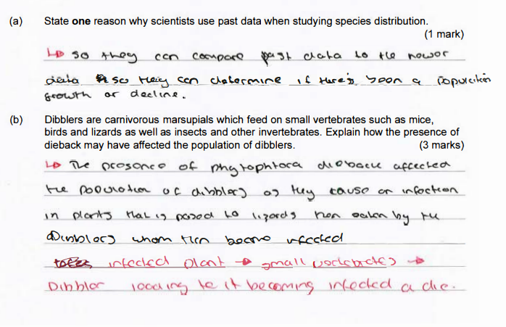
Satisfactory student example
How many marks do you think they received for part a?
1/1
How many marks do you think they received for part b?
0/3

Slide 12
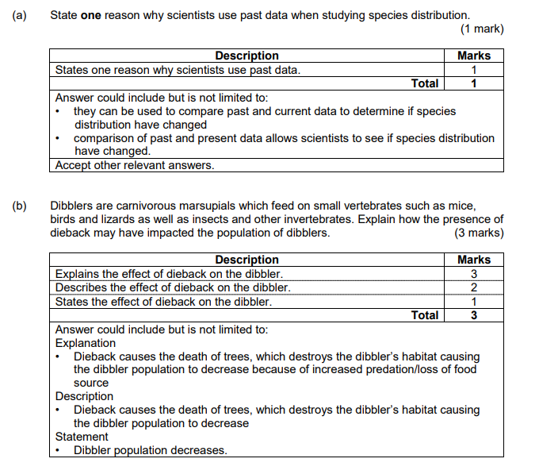
Why the difference in marks?

Slide 13
Questions for you to answer
Go through the following questions and see if you can:
Find where the marks are allocated
Identify each word being used to ask part of the question
Answer the question yourself
A bunch of questions are on SEQTA for you
The marking keys for each question are also provided

